Slide 1
Analyzing Defensive Line Positional Value
Kyle Vander Meulen

Slide 2
Assumptions – Evaluation of Players
EPA is a useful framework for understanding the contributions of individual plays and thus individual players
The EPA given does not take into account the score differential and time remaining
A player’s salary is a key factor in evaluating individual players
In today’s game defending the pass is more important than the run

Slide 3
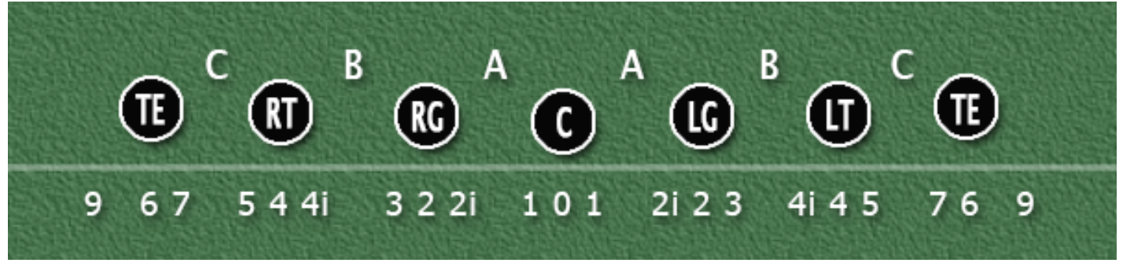
Assumptions – Defensive Line Position
A player whose On Field Position was considered to be Defensive Line regardless of Roster Position.
Roster Positions Tackle (T), Safety (S), and Fullback (FB) were removed because of their singularity with one player representing the entire position.
Additionally, the Technique was considered (0-9) to gain further insight into which locations on the DL had high or low production value.

Slide 4
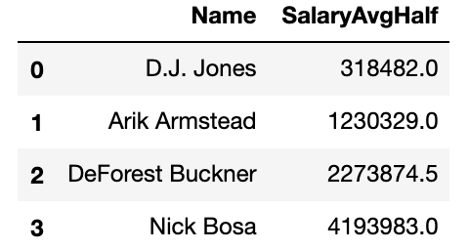
Additional Data
Average Salary
The 2019 average salary for each player was web scraped from spotrac.com and was joined/matched on the player’s name.
The average salary was then adjusted to account for half of the season
SalaryAvgHalf= SalaryAvgFull / 2
https://www.spotrac.com/nfl/salaries/breakdown/2019/defensive-line/

Slide 5
Evaluation Metric Q1 and Q2
Points Above Replacement (PAR)
PAR = EPA – mean(EPA) ~ (PosTechnique~nsmallest(20[SalaryAvgHalf])
PosTechnique = RosterPosition + Technique
e.g: DE0 = DE + 0
The mean(EPA) is calculated based upon the twenty lowest players in SalaryAvgHalf for each PosTechnique (Replacement Value)
The mean EPA is subtracted from the existing EPA to give us how many points a player earned at that PosTechnique on the play
PAR is utilized to evaluate a player’s contribution above being replaced by an ordinary grade player

Slide 6
What is the Most Valuable Defensive Line Position?
1

Slide 7
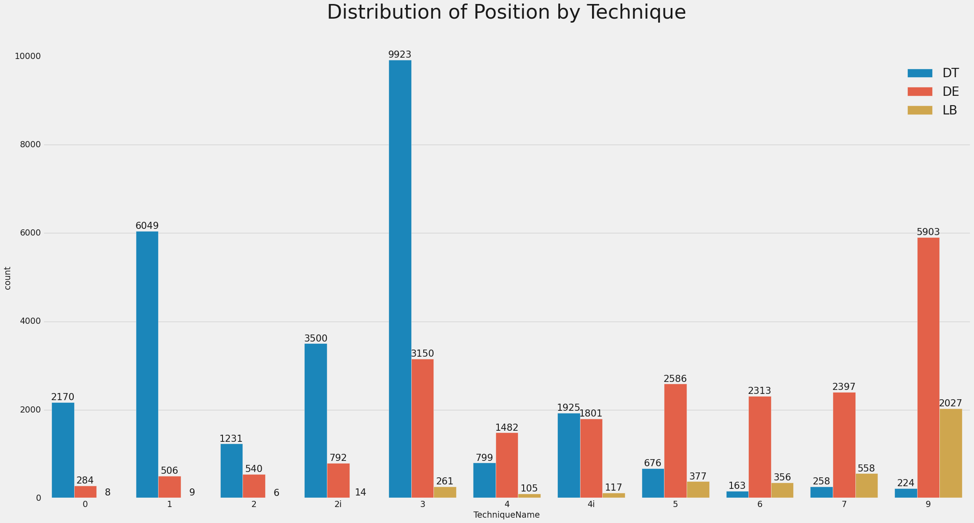
Distribution of Position by Technique
The most utilized position is DT at the 3 Tech
At the DE and LB position the 9 Tech is the most utilized
DT are used inside and DE/LB are used outside

Slide 8
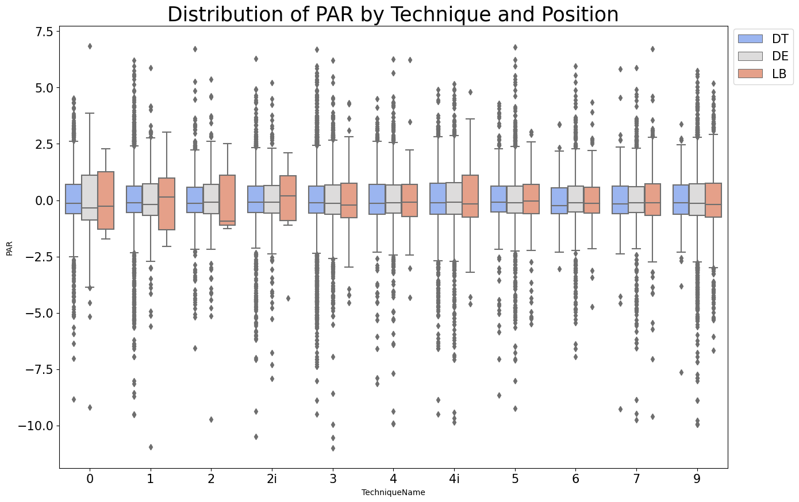
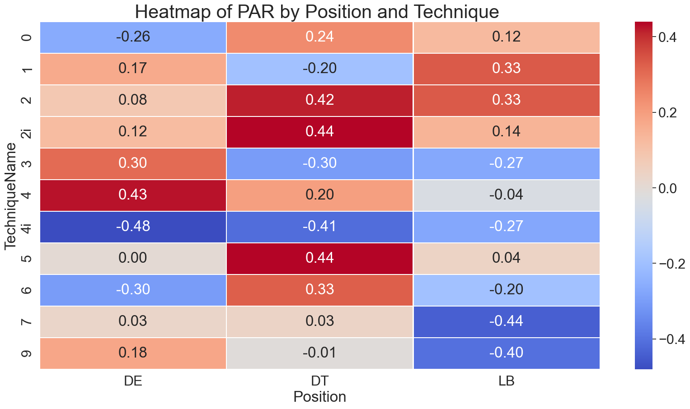
PAR by Position and Technique
The DE at the 4i Tech was the best defensive position in terms of PAR -0.48
The LB position thrived on outside Tech’s 7,9 receiving a PAR of -0.44 and -0.40
The DT position additionally excelled at the 4i Tech with a PAR of -0.41
The 4i Tech was the top Technique, but it’s use rate in games is fairly low

Slide 9
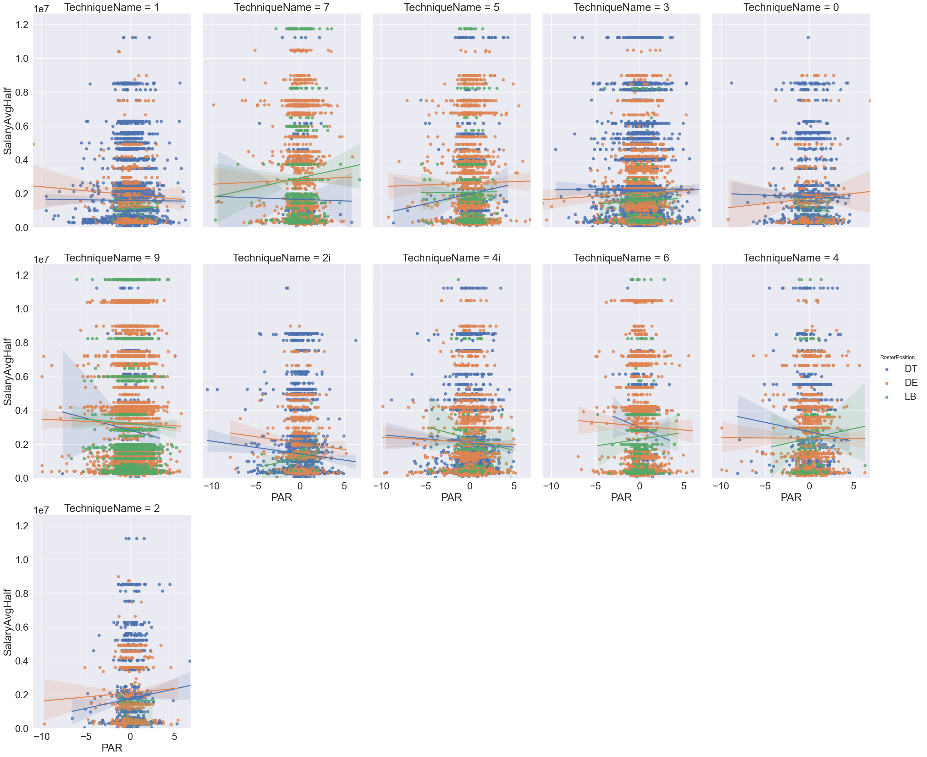
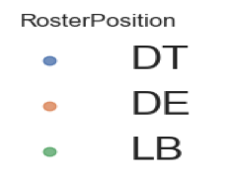
Linear Model of Salary by Position and Technique
Any line that has a upwards trajectory signals that PosTechnique is overpaid based on their PAR
Overpaid PosTechniques:
(DT2,DE2,LB4,
DT5,LB6,LB7)
The opposite is true as a negative line trajectory signals being underpaid

Slide 10
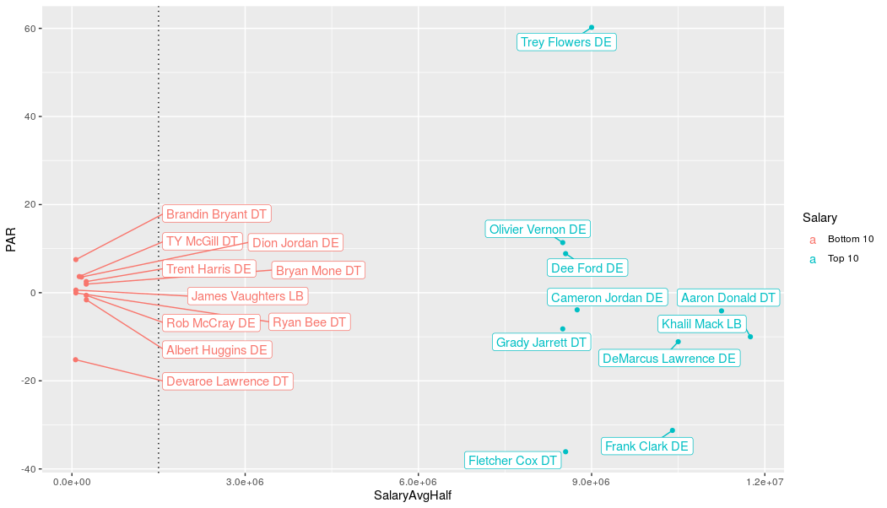
Under/Over Valued Players Based on Salary and PAR
In the bottom 10 cluster we see most points are centered around 0 PAR
There is one exception: Devaroe Lawrence DT is excelling in total PAR production and is being underpaid based upon his performance (He is even outperforming some of the top 10 paid players!)
In the top 10 we see a much larger variation in PAR based on Salary as Trey Flowers DE had poor production for his salary
While Fletcher Cox DT and Frank Clark DE performed at a good PAR for their Salary

Slide 11
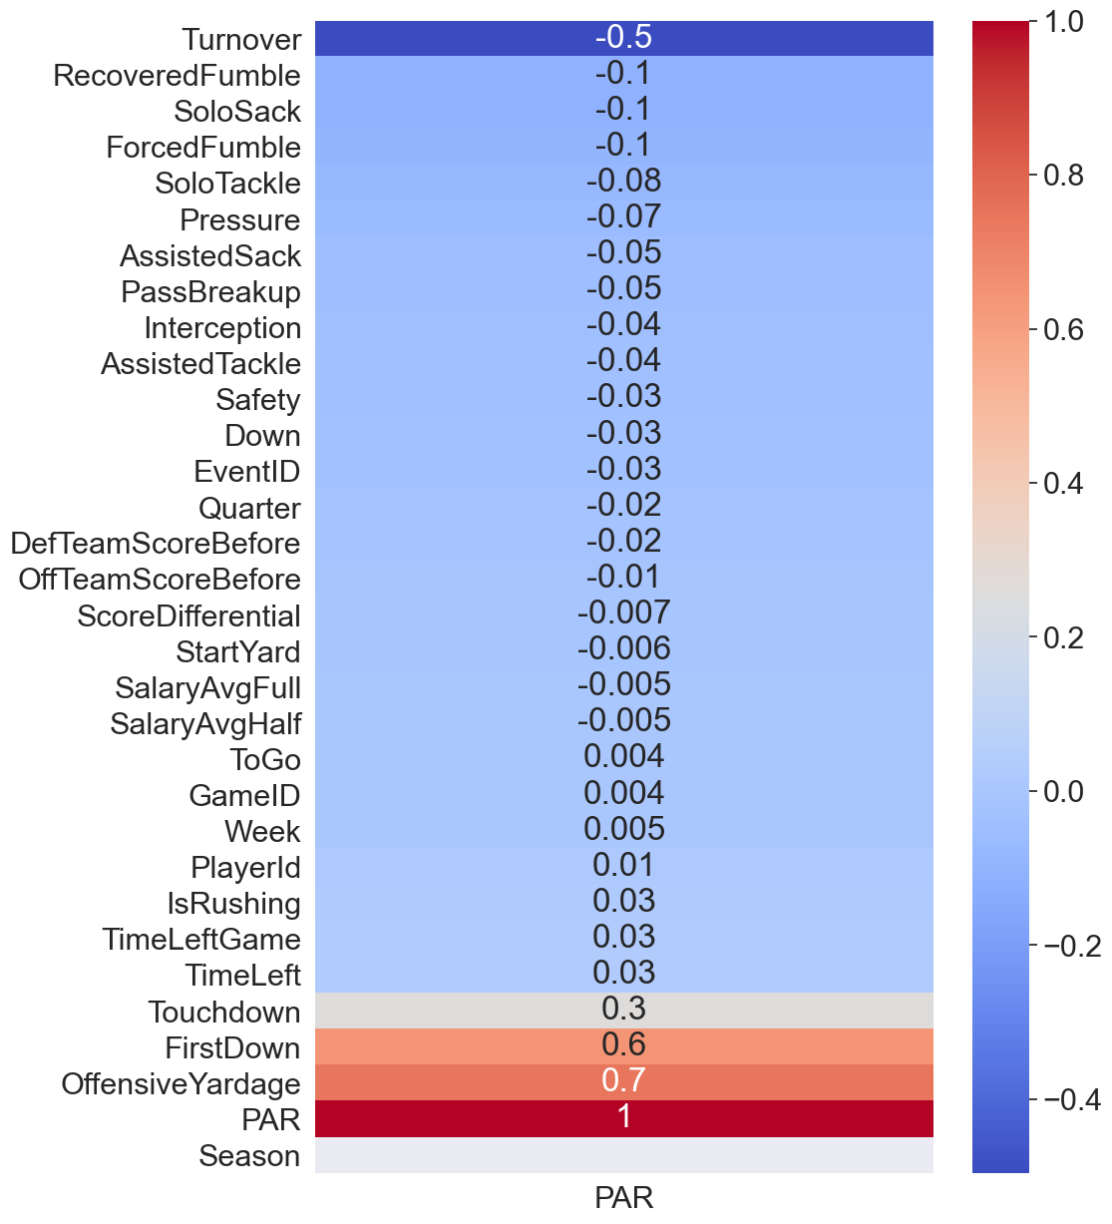
Correlation Matrix of Factors with PAR
The highest positive correlated factors that negatively impacted a player’s PAR were Offensive Yardage (0.7), First Down (0.6), and Touchdown (0.3)
On the other hand, the highest negative correlated factors that positively affected a player’s PAR were Turnover (-0.5), Recovered Fumble (-0.1), Solo Sack (-0.1), Forced Fumble (-0.1)
Based off of the highest negative correlated features (Turnover, Solo Sack, and Forced Fumble) we will delve into the distribution of talent among Defensive Line Positions in the next section

Slide 12
What is the Distribution of Talent Among Defensive Line Positions?
2

Slide 13
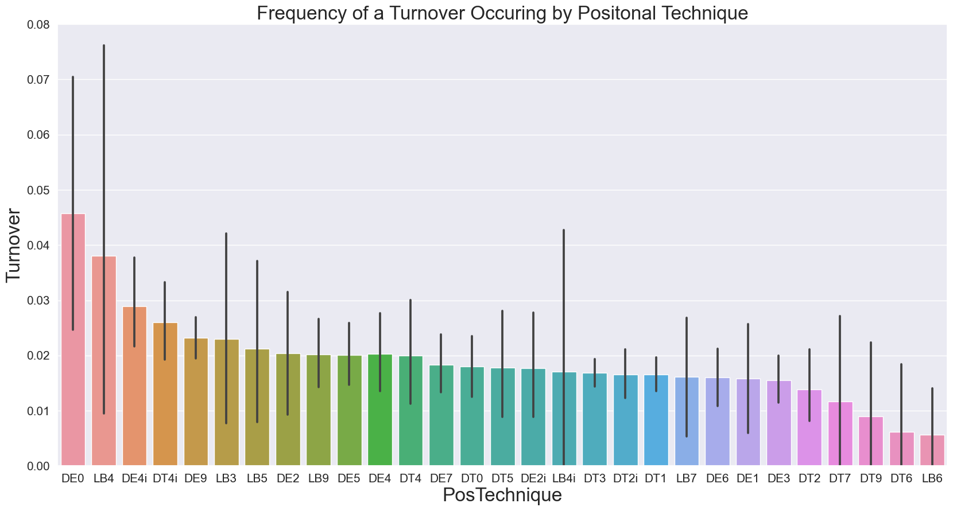
Turnover Frequency by PosTechnique
DE playing at the 0 tech (NT) position had around a 4.5% chance of a turnover happening when they were on the field
Within the top four we see that the tech was either at a 4 or 4i which suggests that when lined up against the RT/LT or on the inside between the RG/LG and RT/LT a Turnover is much more likely to occur

Slide 14
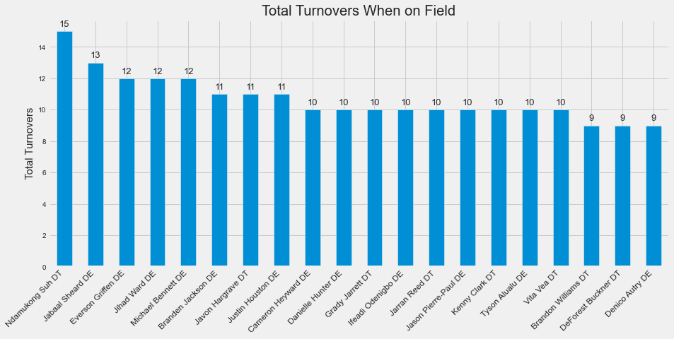
Top 20 in Turnovers Occurring When on Field
Suh led the way with 15 turnovers happening when on the field
Other than Suh the majority of players were DE

Slide 15
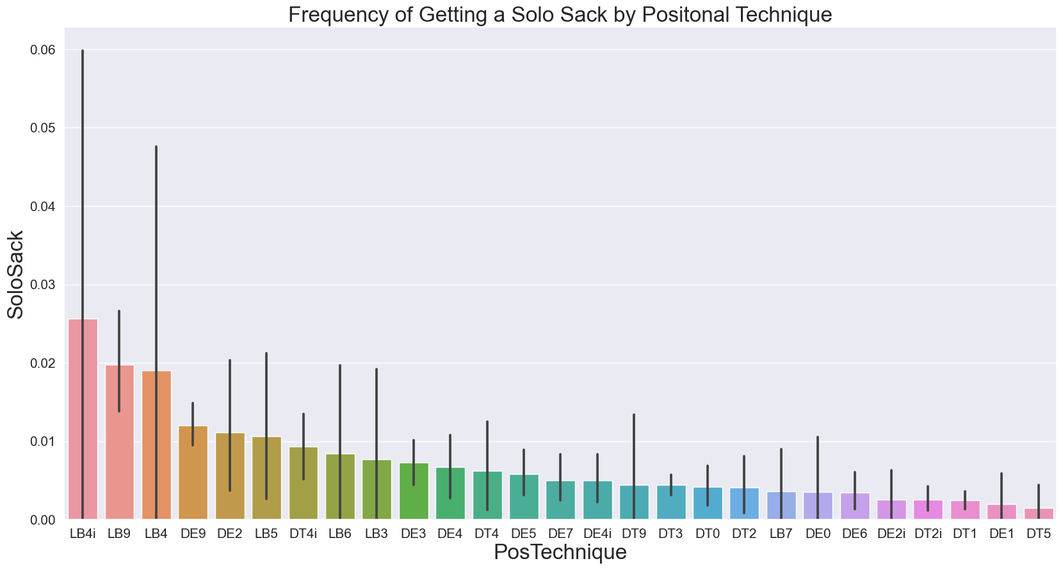
Solo Sack Frequency by PosTechnique
LB 4i led the way with achieving a Solo Sack at a 2.5% clip
The top 4 are either LB or DE on the outside at the 9 Tech or at the 4 Tech
Players lined up on the outside or at the 4/4i technique are performing well in racking up the Solo Sacks

Slide 16
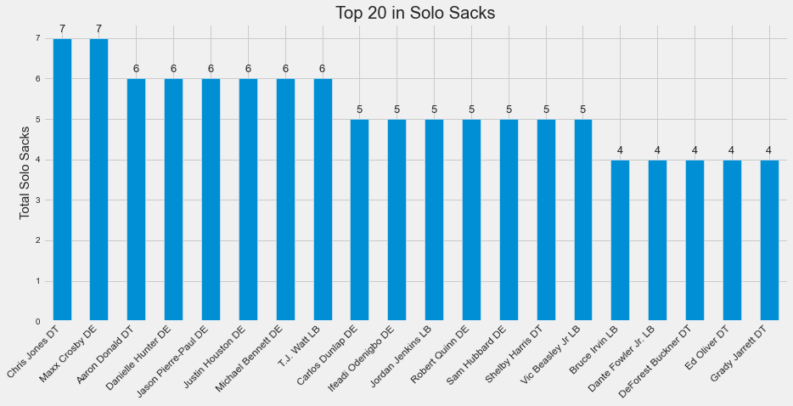
Top 20 in Solo Sacks
Chris Jones and Maxx Crosby (a rookie) led the way in Solo Sacks for the second half of the season
Aaron Donald and Grady Jarrett are the only two top 10 paid players in the top 20

Slide 17
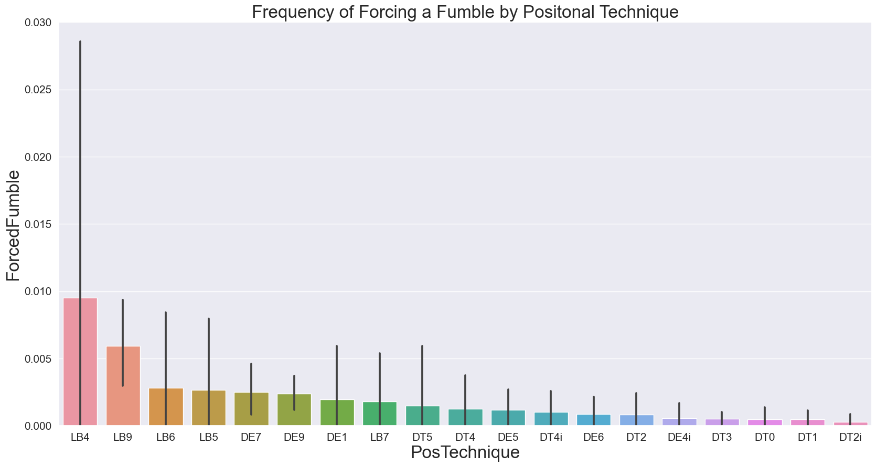
Forced Fumble Frequency by PosTechnique
LB 4 led the way in Forcing a Fumble at a .9% clip
The top 8 are either LB or DE
LB and DE are better at forcing a fumble over DT
LB 4 was 2nd in Turnover Frequency, 3rd in Solo Sack Frequency, and 1st in Forced Fumble Frequency

Slide 18
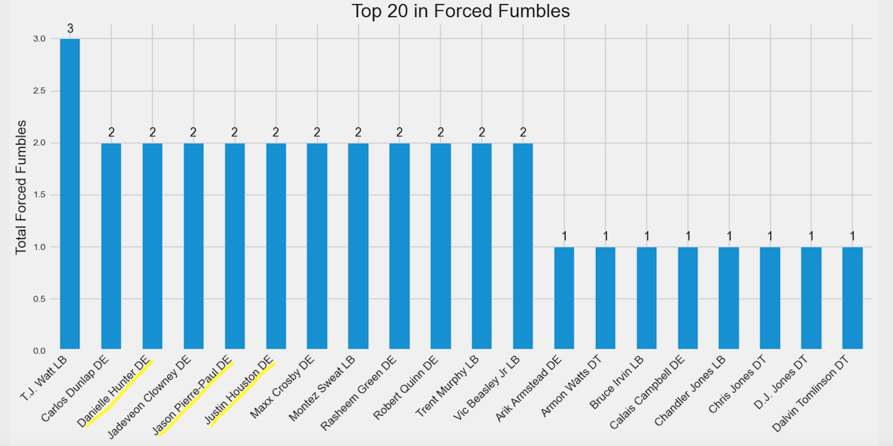
Top 20 in Forced Fumbles
T.J Watt (LB) led the way in Forced Fumbles for the second half of the season
Roster Position was mainly LB and DE
Any underlined player was top 20 across all three factors

Slide 19
Which In-Game Scenarios Change the Most Valuable DL Position?
3

Slide 20
Evaluation Metric Q3
(PAR_crunchtime)
PAR_crunchtime = if PAR is > 0 → PAR + 1/10[PAR]
if PAR < 0 → PAR – 1/10[PAR]
if PAR = 0 → PAR
Crunchtime definition: the quarter is the 4th quarter, time left <= 120 (2 min), and the Score Differential is within the range (-8 to 8). Also if the game is in overtime (5) the crunchtime factor applies as well
The factor rewards defensive players that achieve a negative PAR and penalizes defensive players that achieve a positive PAR

Slide 21
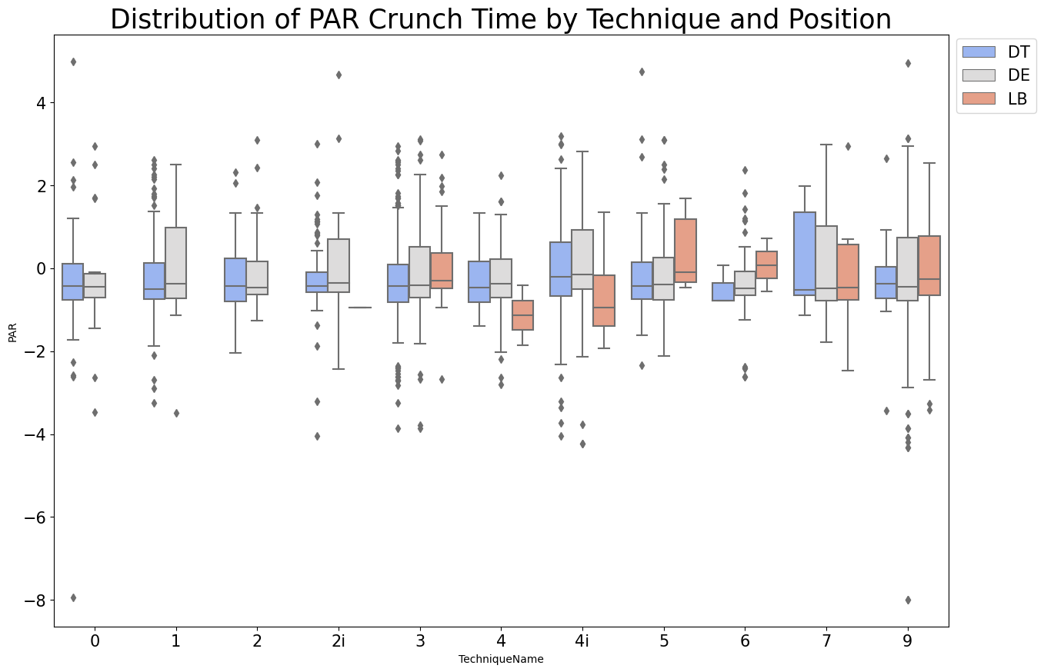
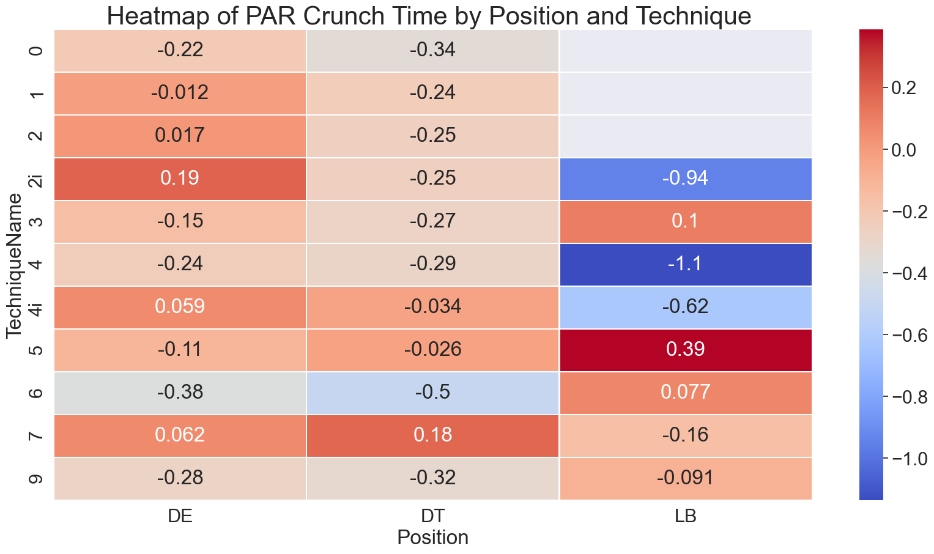
Crunch Time
In Crunch Time it seems that LB’s seem to rise to the occasion. LB’s had three of the highest PAR over DT and DE. LB4 led the way: sounds familiar to the position that led the way in the three factors earlier. Yet when looking at PAR alone LB4 only had a -0.04 effect

Slide 22
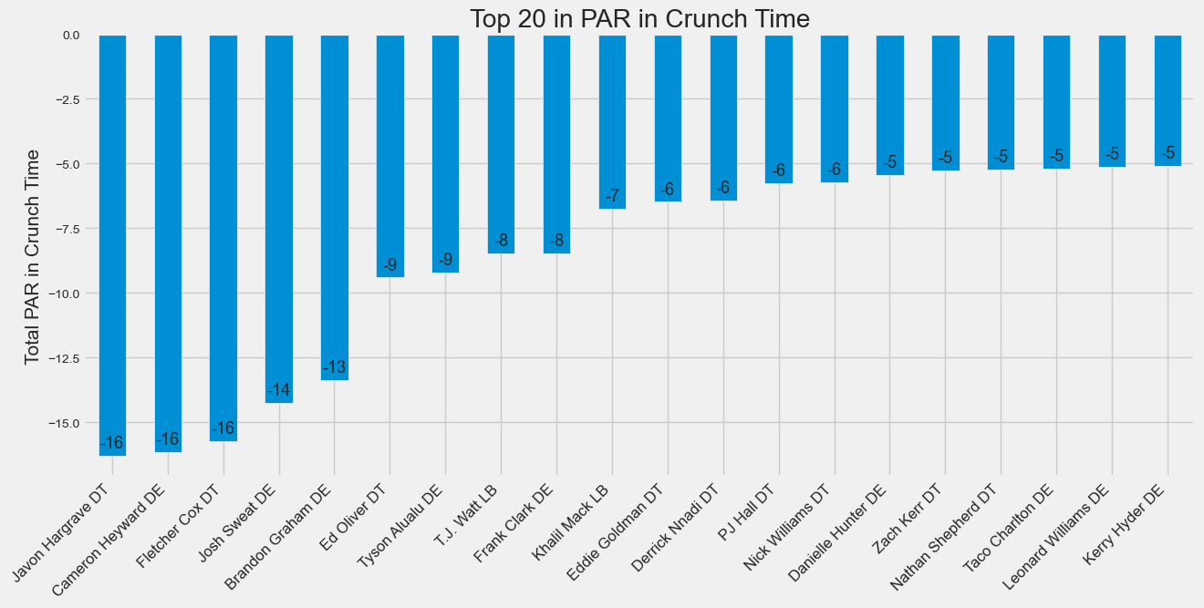
Top 20 in PAR Crunch Time

Slide 23
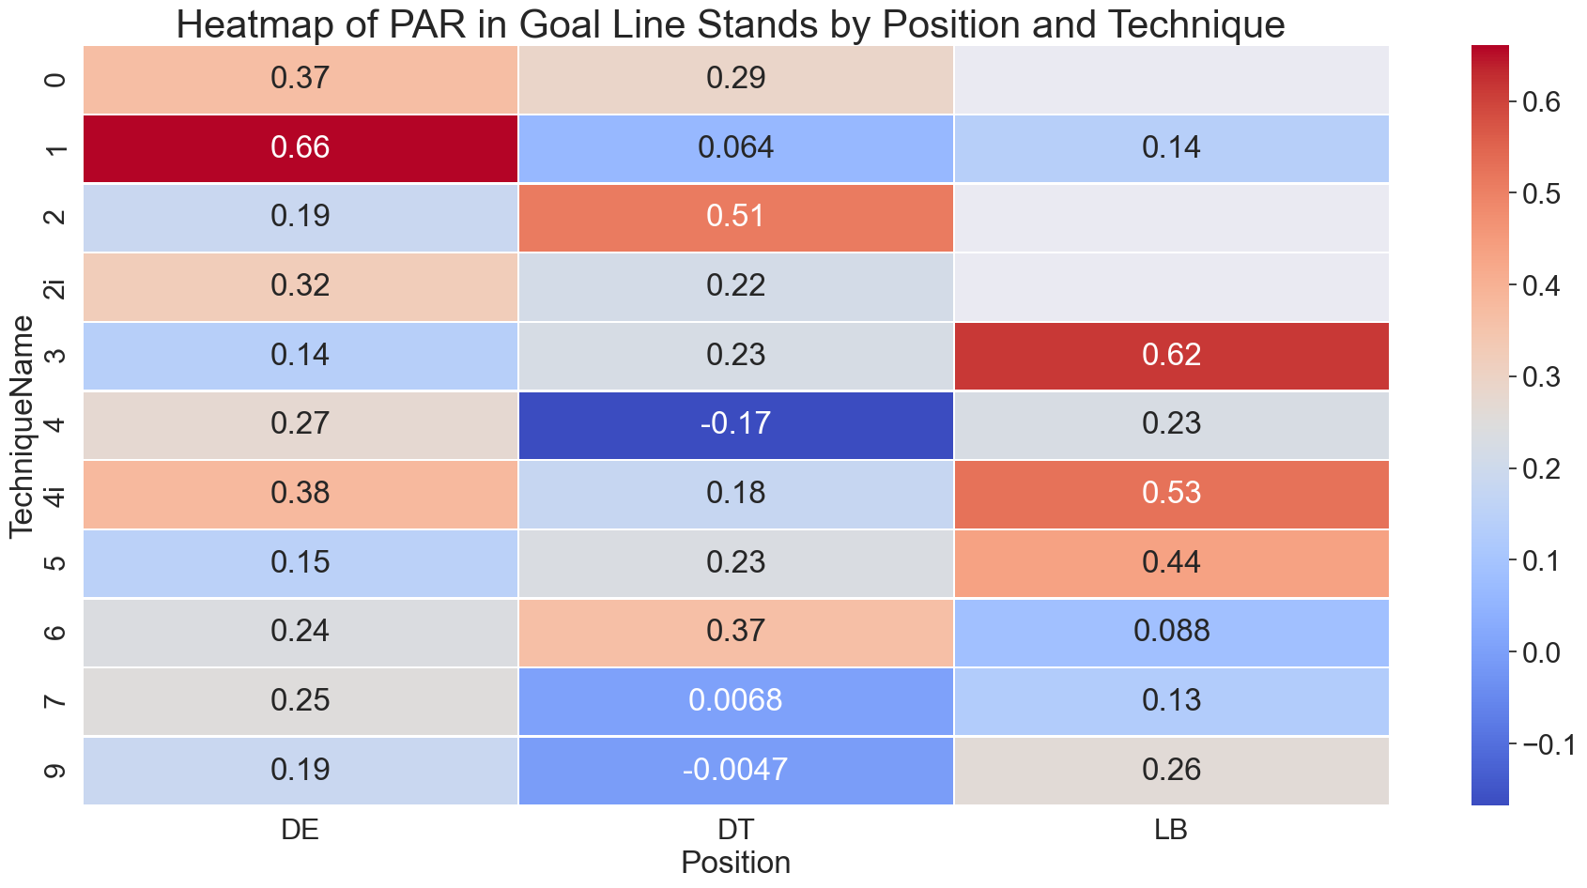
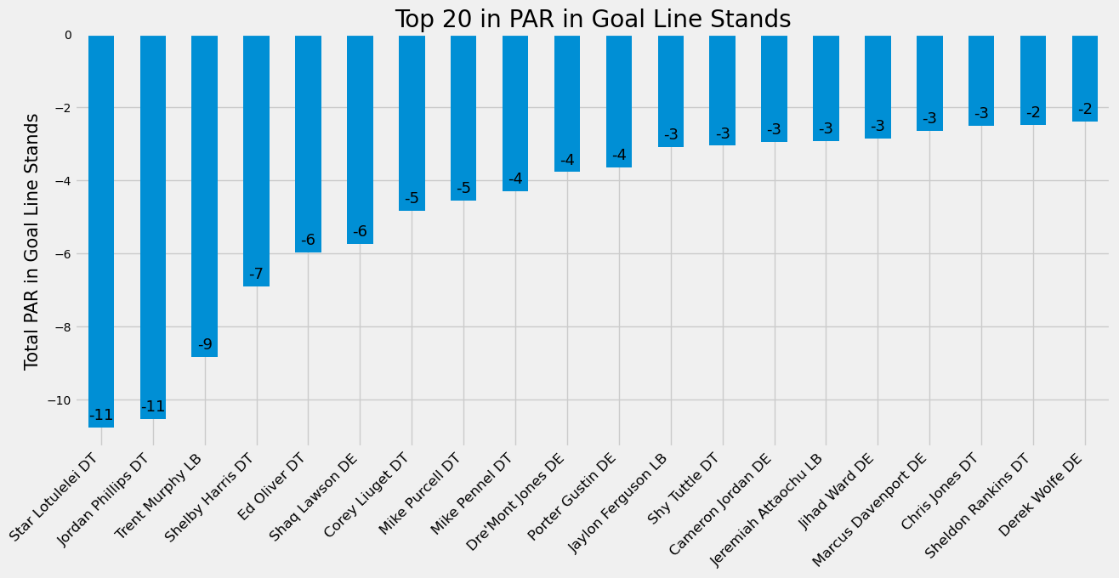
Goal Line Stands (Run)
A goal line stand against the run is any play 5 yards and closer to the goal line on the defense’s side of the field
Extremely difficult for DL players to stop an offensive team 5 yards or closer to the goal line. DT4 and DT9 were the only position that had a negative effect against the offense.
The total yardage on runs was 96,684 | Yards per rush: 4.26 | PCT used : 44.38 %

Slide 24
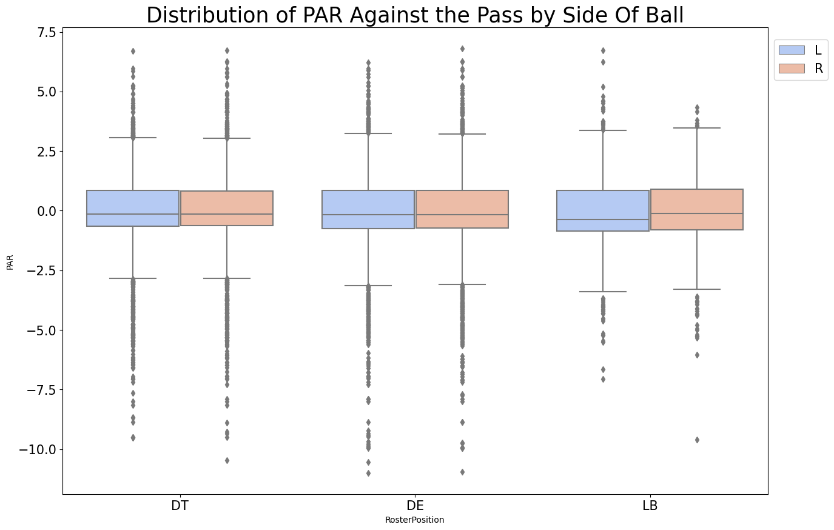
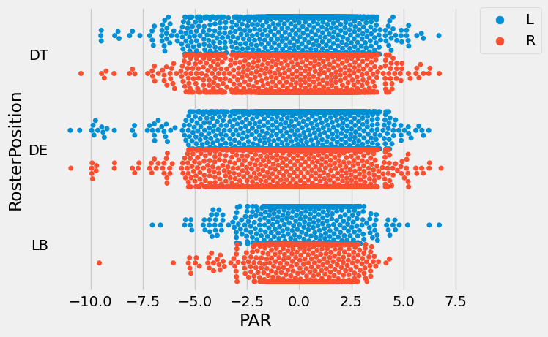
DL Side of Ball (Pass)
The side of the ball has little to no difference in a player’s PAR
Since all current QB’s are right handed, shouldn’t the DL lined up on his blind side (Right) excel more?
What will be the defensive strategy be against the emerging Tua, who is a lefty?
The total yardage on passes was 172,606 | Yards per pass: 6.08 | PCT used : 55.62%

Slide 25
Final Answers
1) Best DL Position: The DE at the 4i Tech was the best defensive position in terms of PAR -0.48
The 4i Tech was the top Technique, with an average of -0.39 across all three positions
Some players are underpaid (Devaroe Lawrence) and overpaid (Trey Flowers) based off of their PAR
2) Distribution of Talent:
Highest Frequency of a Turnover Occurring when on Field: DE playing at the 0 tech 4.5%
Highest Frequency of a Solo Sack: LB at the 4i Tech 2.5%
Highest Frequency of Forcing a Fumble: LB at the 4 Tech .9%
Best all around position: LB 4 Tech | 2nd in Turnover Frequency, 3rd in Solo Sack Frequency, and 1st in Forced Fumble Frequency
3) In Game Scenarios:
Crunch Time: LB 4 Tech had the best PAR crunch time -1.1
Goal Line Stands: DT 4 Tech had the best PAR -0.17
Side of Ball: Had little impact on a player’s PAR

Slide 26
Limitations and Future Analysis
Limitations:
Not having the full year dataset skews the results. As in the second half of the season, teams that have already clinched a playoff spot might play certain players over starters and at different techniques
Not knowing the offensive and defensive formations: We are unable to measure how well the offense is exploiting the defensive formation and how well the defense can adjust to the offense formation
A Win Probability Added (WPA) metric that looks at which players contributed most to a win or loss
A start time of game variable to assess day/night/primetime games
Future Analysis:
Discover replacement values for production factors and adjust for position difficulty
Use a multinomial logistic model to relevel EPA or PAR (high, medium, low) and discover the log odds of these outcomes as a linear combination of the predictor variables.
Look more into team usage of positional techniques and how efficient they are in their defensive schemes
Delve more into passing situations as it is more relevant, because of the total production, yards per pass, and use rate

